Slide 1
Demonstration of Github Repository List Application
CHITTIMELLI MAHESH (1893655)
AKHIL REDDY MEDAPATI (1893768)
NARASIMHA REDDY PATEL(1893991)
SHILPA SHARMA (1893584)
RAJWINDER SINGH (1795544)

Slide 2

GITHUB API:
https://api.github.com/repositories
The api cited above gives the data of various git repositories by users on github.
It gives information about repository description, owner details, languages used to code it, other info.
Data of these repositories is fetched and presented in a user friendly manner for better understanding (in our app – Liste de referential..!)

Slide 3
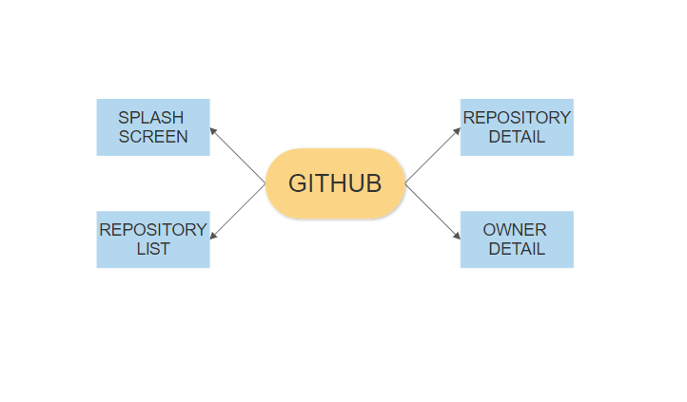
Activities:

Slide 4

Splash Screen:
The immediate screen which opens after opening the app is Splash screen. In splash screen we can clearly see the logo of the GITHUB.

Slide 5
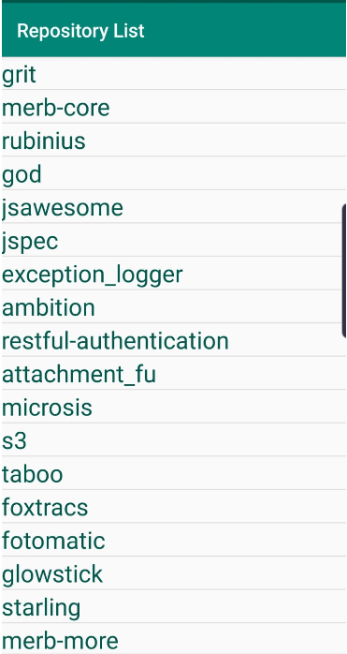
List of Repositories:
There is no limitation for the list of repositories. We can add as many as we can. For the ease we have limited our number of repositories to 30. On Clicking the particular repository, we can access the repository detail, image etc.

Slide 6
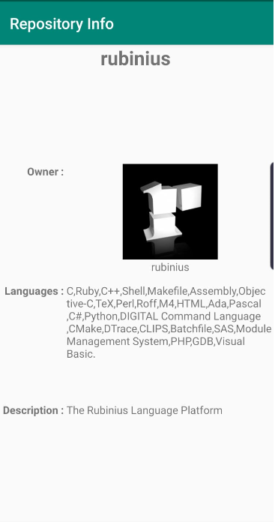
Repository Details:
If we get into the repository details, we can find the detail of the particular owner with an image of the owner. Here we can find the information of the repository named rubinius. We can clearly observe the owner’s image, details and description in the picture shown.

Slide 7
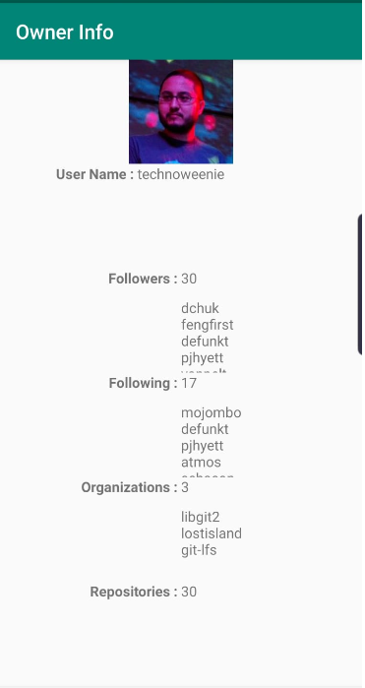
Owner Information:
One can get complete information regarding the owner in this. User name, number of followers, following, total number of Organisations and repositories.

Slide 8
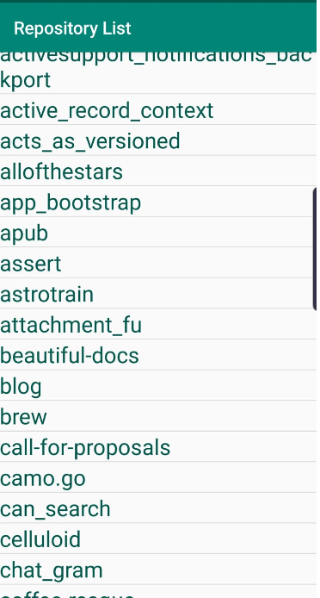
Owner’s Repositories:
The owner repository has the list of repositories which will redirect us to home screen.

Slide 9
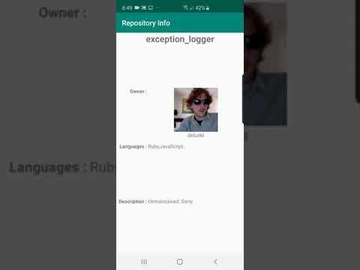
VIDEO:

Slide 10
Code Demonstration will be followed

